Slide 1
Coal India Limited
Auction of Coal Linkages in the Cement Sub-Sector –
Phase II of Tranche I
Pre Bid Presentation
This presentation is for ease of understanding of the Scheme by the Bidders. In case of any discrepancies between this presentation and the Scheme Document, the provisions of the Scheme Document will prevail.
June 19, 2016

Slide 2
AGENDA
Background
Key Auction Principles
Auction Methodology
Key Terms
Eligibility Criteria
Conditions to E-Auction
E-Auction Process
Payments
Key FSA Terms & Modifications to existing FSA

Slide 3
BACKGROUND

Slide 4
Overview
Dec 2006
Coal being a scarce commodity, its utility for the purpose for which it is needed is essential
Sep 2014
Supreme Court cancelled coal block allocations since 1993 on the grounds that the procedure followed was arbitrary and no objective criterion was used
Mar- Sep 2015
IMC constituted for examining allocation of coal linkage through market-based mechanism
IMC agreed on auction of coal linkages to non-regulated sector through competitive bidding
Feb 2016
Feb 2016
On Feb 3, 2016, CCEA approved that all allocations of coal linkages/Letter of Assurance (LoAs) for non-regulated sector shall henceforth be auction based
MoC has issued letter to CIL and SCCL dated Feb 15, 2016 (“Policy”),
Details of procedure for the methodology shall be worked out by CIL
Nobody should be allowed to take undue advantage while dealing with a scarce commodity
Supreme Court judgment in Ashoka Smokeless Case: 2 Principles
Auctions shall be conducted by Coal India Ltd (CIL) & SCCL
E-auction of Coal Mines conducted in accordance with Coal Mines (Special Provisions) Act, 2015

Slide 5
Policy Guidelines for Auction
Proportion of coal allocation between power and non-power sector at 75% and 25% respectively as per CCEA decision
Sub-sectors could be Cement, Sponge Iron/Steel, Aluminium and Others [excl. Fertiliser (Urea)] including their CPPs etc.
Existing FSAs of non-regulated sector
  No premature termination
  No renewal except FSAs of CPSEs and Fertiliser (Urea)
  In case CPSE’s want additional linkages they will have to participate in the auction for such additional quantity.
Quantity for Tranche I shall be aggregate of FSAs of non-regulated sector maturing in FY2016 onwards & 25% of incremental CIL/SCCL production during FY2016 over FY2015
Separate quantities to be earmarked for sub-sectors
CIL will allocate coal from area or mine within a subsidiary, as deemed fit
FSA tenure may be as decided by MoC, subject to a maximum tenure of 15 years

Slide 6
Policy Guidelines for Auction ...2
Bid parameter shall be Premium over Notified Price of coal
Auction methodology shall be Non Discriminatory Ascending Clock Auction
  Auctioneer increments the Premium on electronic platform till demand supply equilibrium is established
Premium shall remain constant over contract period; Notified price to be paid shall be suitably indexed on semi annual basis
Bidders can bid up to normative annual coal requirement of the end use plant (EUP)
Provision for third party sampling for coal supplied
CIL/SCCL shall chalk out annual or 6-monthly auction calendar
Based on experience of Tranche I, operational details may be appropriately reviewed

Slide 7
KEY AUCTION PRINCIPLES

Slide 8
Sub-sectors for Auction
It has been decided to conduct the current auction of coal linkages under non-regulated sector (Tranche I) under the following sub-sectors:
  Cement (excluding its CPPs)
  Sponge Iron (excluding its CPPs)
  All Captive Power Plants (CPPs)
  Steel (Coking Coal)
  Others [excluding Fertilizer (urea) sector]
All EUPs that do not fall under (a), (b), (c) and (d) above are included in “Others” sub-sector.
To start with, Scheme Document for the ‘Sponge Iron’ sub-sector was uploaded on May 26, 2016 and auction was conducted during June 10-16, 2016 (“Phase I”)
Auction for the sub-sector ‘Cement’ to be conducted (“Phase II”)

Slide 9
Allocation of Coal Quantity
For the purpose of the first tranche of linkage auction, total quantity is ~ 23.25 Million Tonnes (MT)
Of the above quantity allocated to the “Cement (without CPPs)” sub-sector is ~2.15 MT
These quantities are tentative and are subject to modification

Slide 10
Cut-off date of Auction
  For linkages which have expired / are due to expire by June 30, 2016, the following guidelines will apply:
    For bidder who participated in the auction and won back part / full of such quantity, the quantity won back shall be supplied till the execution of new FSA
    For bidder who has either not participated or not won back part / full of such quantity, the supply for quantity not won back shall be stopped after June 30, 2016
  Bidders will not be allowed to bid for any linkage quantity against which they have a valid FSA which is expiring post June 30, 2016
  For linkages which are due to expire post June 30, 2016, the extant coal supply arrangements from such linkages may continue till the next linkage auction’s Cut-off date (will be specified later)
  Bidders with tapering linkages are allowed to participate in the linkage auction

Slide 11
Bidding Parameter
  The auction will commence at the Reserve Price (Floor Price) and the bidders shall bid for premium above the Reserve Price and for a particular Quantity.
  Reserve Price
    Reserve Price shall be the notified price published for a particular grade of coal

Slide 12
Timeline for Auction – Cement Sub-Sector
Event | Estimated Date
Publication of Notice Inviting Application | Saturday, June 11, 2016
Upload of Scheme Document | Saturday, June 11, 2016
Start of Registration Process | Monday, June 13, 2016
Pre-Bid Conference | Sunday, June 19, 2016
Period for submission of information, documents and payments pertaining to Conditions to Auction | Monday, June 20, 2016 to at least 1 (one) business day prior (till 17:00 hours IST) to the date of auction of the Lot in which the Bidder intends to participate
Mock Bidding Session | MSTC to send out notifications
Scheduled Start of e-auction | Tuesday, June 28, 2016

Slide 13
AUCTION METHODOLOGY

Slide 14
Auction Process
Method of Bidding – Non-Discriminatory Ascending Clock Auction Process
Online Electronic Auction Platform
Registration on Auction Platform; No physical bids
Conditions to Auction
Auction Platform to display Normative Coal Requirement
Non-Discriminatory Ascending Clock Auction Process
Increase in Premium till Demand Supply equilibrium is established

Slide 15
Auction Process …2
  Bidder should visit the website of MSTC website for registration www.mstcecommerce.com/auctionhome/coallinkage/index.jsp
  Bidder registration on the Auction Platform is proposed to be linked to an End Use Plant (EUP)
  Any Bidder as defined in the Scheme Document having one or more Kilns i.e. Clinker manufacturing units (in a single location within the same boundary) located in India shall be allowed to participate. All CPPs and units other than Clinker manufacturing units will participate in the auction of their particular sub-sectors.

Slide 16
Auction Process …3
  Bidder will have to register each EUP on the MSTC system
    Combination of units located within the same plant boundary is allowed to be registered as one EUP. However, once the units are combined and registered as single EUP, they cannot be split subsequently.
  For registering under the auction portal, the Bidder will provide the following:
    Company Name
    Name of EUP (auction portal will generate a unique registration number for each EUP)
    Sub-sector in which each EUP is applying
    Self-attested copy of Income Tax PAN Card
    Self-attested copy of VAT/ CST Registration certificate

Slide 17
Auction Process ...4
Auction process shall consist of: Conditions to Auction and Non-Discriminatory Ascending Clock Auction Process
As a part of Conditions to Auction, Bidders shall provide the following details:
  Technical data of EUP
  Details of any existing coal linkages (expiring after June 30, 2016) for the above EUP
  Details of any coal mine allocated under CMSP and/or MMDR Acts
  Based on the above the system will calculate the Normative Coal Requirement of the EUP.
  Following this the Bidder shall deposit the necessary Bid Security and the Process Fee
  Bidders shall also submit certain other documents (both hard copy and soft copy format) such as Notarized Power of Attorney and Affidavit, Board Resolution (if required) etc.
  Post submission of the requisite information/payments, e-auction process will commence wherein the bidders are required to bid for quantity against a certain price.

Slide 18
Auction Process ...5
After completion of the auction of each Lot, Successful Bidder(s) for that lot will be announced.
Such Successful Bidder(s) shall be issued a Letter of Intent (“LOI”) within 15 (fifteen) days of completion of the Phase II Auction (for Cement sub-sector) which will include the cumulative Allocated Quantity of such Bidder from the relevant CIL subsidiary, pursuant to the Phase II Auction.
The Successful Bidder shall, within 45 (forty five) days of issuance of the LOI to it, submit the Performance Security to the relevant Subsidiary.
The Agreement (FSA) shall be executed between the Successful Bidder and the relevant Subsidiary in respect of the Allocated Quantity within 30 (thirty) days of:
  receipt of the Performance Security; and
  submission of the documents specified in Scheme Document.
Bidders will have to execute separate FSAs for each Lot where they emerge as Successful Bidders.

Slide 19
KEY TERMS

Slide 20
Normative Coal Requirement
  As per Para 2(g) of the Policy, maximum bid quantity by a particular bidder shall not exceed the Normative Coal Requirement of the End Use Plant (EUP).
  Normative Coal Requirement for each EUP in the “Cement” sub-sector will be calculated by the auction platform based on the norms provided in CIMFR’s report titled “Setting up of modalities for Normative Coal Requirement in respect of cement and sponge iron industries” with reference no TR/CIMFR/1.39/14-15.

Slide 21
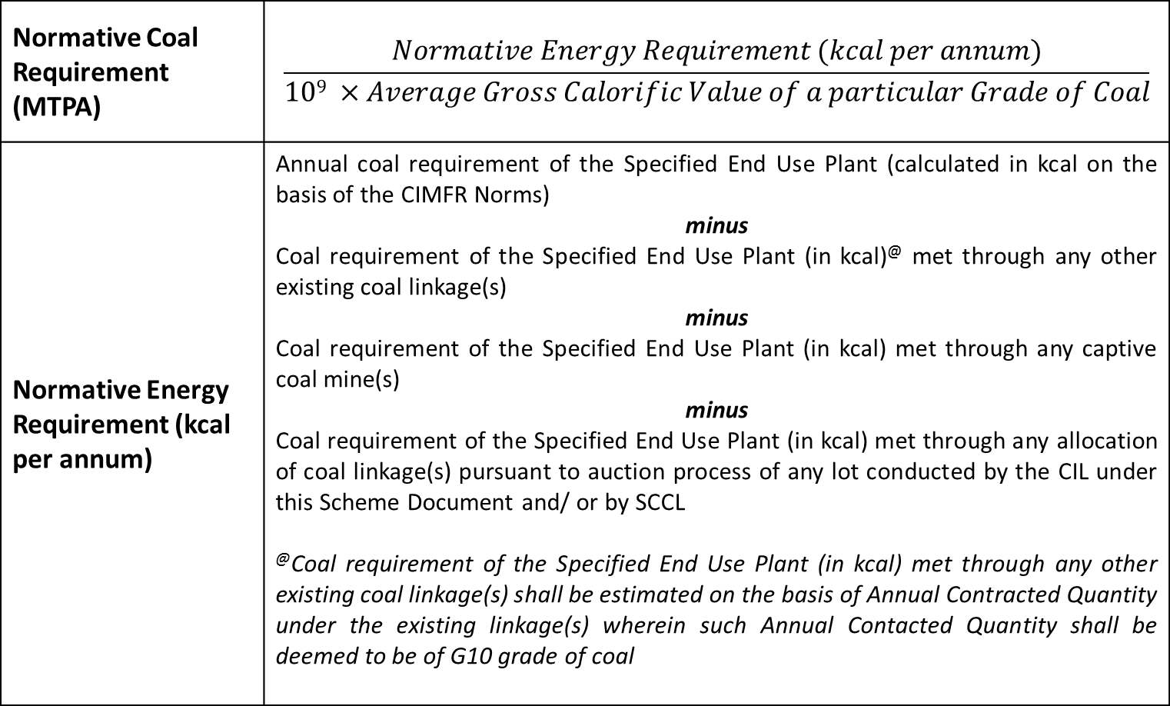
Normative Coal Requirement…2
Normative Coal Requirement (MTPA) | $$\frac{Normative Energy Requirement (kcal per annum)}{109 ×Average Gross Calorific Value of a particular Grade of Coal}$$
Normative Energy Requirement (kcal per annum) | Annual coal requirement of the Specified End Use Plant (calculated in kcal on the basis of the CIMFR Norms) minus Coal requirement of the Specified End Use Plant (in kcal)@ met through any other existing coal linkage(s) minus Coal requirement of the Specified End Use Plant (in kcal) met through any captive coal mine(s) minus Coal requirement of the Specified End Use Plant (in kcal) met through any allocation of coal linkage(s) pursuant to auction process of any lot conducted by the CIL under this Scheme Document and/ or by SCCL @Coal requirement of the Specified End Use Plant (in kcal) met through any other existing coal linkage(s) shall be estimated on the basis of Annual Contracted Quantity under the existing linkage(s) wherein such Annual Contacted Quantity shall be deemed to be of G10 grade of coal

Slide 22
Example – Normative Coal Requirement Calculation
(+) | Annual Coal Requirement of the Specified End Use Plant (based on G10 grade) | 5,00,000 TPA
(–) | Coal requirement of the Specified End Use Plant met through any other existing coal linkage(s) (deemed at G10 grade) | 1,00,000 TPA
(–) | Coal requirement of the Specified End Use Plant met through any captive coal mine(s) (quantity adjusted to correspond to G10 grade) | 1,50,000 TPA
 | Normative Coal Requirement | 2,50,000 TPA

Slide 23
Lots & Auction Sequence
  ‘Lot’ shall mean a specified quantity of coal belonging to a particular grade which is to be offered for sale and which may be dispatched by road or by rail
  Each Lot will contain only one Grade
    Each Lot will also have a pre-identified Secondary Source
  Each Lot will have a specified mode of dispatch i.e. road or rail. Bidders will have to off-take coal from Lots via the specified mode of dispatch only
  In case of a force majeure event or other operational constraints, CIL may supply coal from other mine(s) (Road Sale Points)/ railway siding i.e. Secondary Source and make necessary steps to revert to the primary source as soon as it is operationally possible
  Details of Lots have been provided in the Scheme Document
  Auction of Lots will be conducted sequentially
  Sequence and schedule of Lots will be provided upfront to the Bidders
S. No. | Subsidiary Name | Mine/ Siding | Mode | Grade/ Size | Quantity | Notified Price | Secondary Source

Slide 24




Specified End Use Plant for Cement Sub-Sector
Specified End Use Plant” shall mean a Kiln (or a combination of Kilns within a single plant boundary) located in India and owned by the Bidder
Company ‘A’ has an Integrated Cement Plant with Kiln, and Captive Power Plant
Only Kiln will participate for auction of Lots under Cement sub-sector
Accordingly, Bidder to mention the plant capacity of Kilns or Clinker manufacturing units strictly
Bidders having multiple Kilns within the same plant boundary can combine such units and register as one EUP.
Kiln
CPP Unit
☑
☒
Kiln 1
Kiln 2
Kiln 3
EUP 1

Slide 25
ELIGIBILITY CRITERIA

Slide 26
Eligibility Criteria
Composition of the Bidder
Any resident Indian Person including a Proprietorship/partnership firm registered in India
Ownership of End Use Plant (EUP)
Bidder to own the EUP
Status of End Use Plant
EUPs should have commenced commercial operations
Normative Coal Requirement
Calculated at 85% Plant Capacity Utilisation and bidders may bid up to 100% of their Normative Coal Requirement
Companies incorporated in India
EUP to be located in India
Coal to be used for own consumption
To be net of requirement being met from other linkages and / or captive coal mine
Minimum Normative Coal Requirement should be 4,200 TPA

Slide 27
Eligibility Criteria …2
No. of Bids by a Bidder
With respect to one specified EUP, Bidder is required to submit information/documents and payments as required under Conditions to e-Auction
Other Conditions
Bidders with criminal conviction with respect to misutilisation of coal allocated through FSA will not be eligible.
With respect to one EUP, the Bidder may submit financial bid for multiple Lots
No transfer of linkage is allowed under the current linkage auction process. However change of control may be considered as specified in the Scheme Document.

Slide 28
CONDITIONS TO E-AUCTION

Slide 29
EUP Details
As a part of Conditions to Auction, Bidders shall provide their EUP details for computation of the Normative Coal Requirement of the plant.
Following Details are required for this purpose:
  Details of the EUP including capacity
  Details of existing coal linkage(s) if any
  Details of existing Captive Coal Mine, if any
  The same are required in the format as provided on the electronic platform.

Slide 30
Bid Security
  Bidder shall furnish, a bid security in the form of an Earnest Money Deposit (EMD).
  The Bid Security shall be Rs. 100 per tonne of the quantity the bidder intends to bid across various Lots.
  The payments made by Bidders towards the Bid Security shall be collected in a designated bank account as mentioned in the Scheme Document
  The Bidder shall ensure that at any time during the auction process, its Bid Security is adequate vis-à-vis the intended Link Quantity.
    The Bidder has the flexibility to top up the Bid Security at least 1 business day prior to the scheduled auction of Coal Linkages pertaining to the Lot.
    Under no circumstances, the bidder shall be allowed to bid for a quantity for which the Bid Security has not been deposited.
  Refund of Bid Security
  The Bid Security pertaining to the Allocated Quantity of the Successful Bidder will be returned by the relevant Subsidiary to the Successful Bidder, without any interest, post submission of executed copies of FSA to the relevant Subsidiary
  The balance Bid Security of the Successful Bidder, if any, and the entire Bid Security of unsuccessful Bidders shall be returned without any interest, post completion of the Phase II Auction (for Cement sub-sector)

Slide 31
Bid Security …2
  Conditions for forfeiture of Bid Security
  The information, documents and/ or payments with respect to the Conditions to Auction are determined to be non-responsive
  Engagement in a Corrupt Practice, Fraudulent Practice, Coercive Practice, Undesirable Practice or Restrictive Practice
  In case of a Successful Bidder, failure to submit within 45 days of issuance of the LOI, the following:
    Performance Security
    The documents specified in Annexure IX of the Scheme Document and other documents as may be requested by CIL or the relevant Subsidiary
  Failure to execute the Agreement within the time period specified in the Scheme Document
  In which case, the Bidder will also cease to be a Successful Bidder.

Slide 32
Process Fee
  Along with Bid Security, the Bidders shall also be required to submit a process fee in the form of an earnest money deposit within the stipulated timeline which is Rs. 2.50 per tonne (inclusive of service tax) multiplied by the Link Quantity across various Lots
  The Bidder shall ensure that the Process Fee shall, at any time during the auction process, correspond to its intended Link Quantity across various Lots
  In case a Bidder decides to change the bidding strategy by opting to Bid for a different Link Quantity in a specific Lot, which requires additional Process Fee to be paid, the Bidder shall be required to top up the Process Fee no later than 1 business day prior to the scheduled auction of the Coal Linkages from the relevant Lot
  The payments made by Bidders towards the Process Fee will be paid into a bank account as stipulated in the Scheme Document
  The Process Fee pertaining to the Allocated Quantities of each Successful Bidder will be debited towards transaction expenses for running the auction process and the balance shall be refunded, without interest
  In the event that a Bidder does not qualify as a Successful Bidder, the entire amount of the Process Fee, without any interest, shall be refunded to such Bidder after completion of the Phase II auction for cement sub-sector

Slide 33
Other Documents
A power of attorney in the format set out in Annexure III of the Scheme Document along with a certified true copy of the relevant authorizations in support thereof e.g. letter of authority, resolution of the board of directors, resolution of the shareholders etc.; and
An affidavit in the format set out in Annexure IV of the Scheme Document certifying inter alia that they meet all the Eligibility Conditions required for participation in the auction process hereunder.
An Undertaking in the format set out in Annexure II undertaking to perform activities required for submitting the bid in the manner prescribed in the Scheme Document and certifying that he shall continue to satisfy all the Eligibility Conditions

Slide 34
E-AUCTION PROCESS

Slide 35
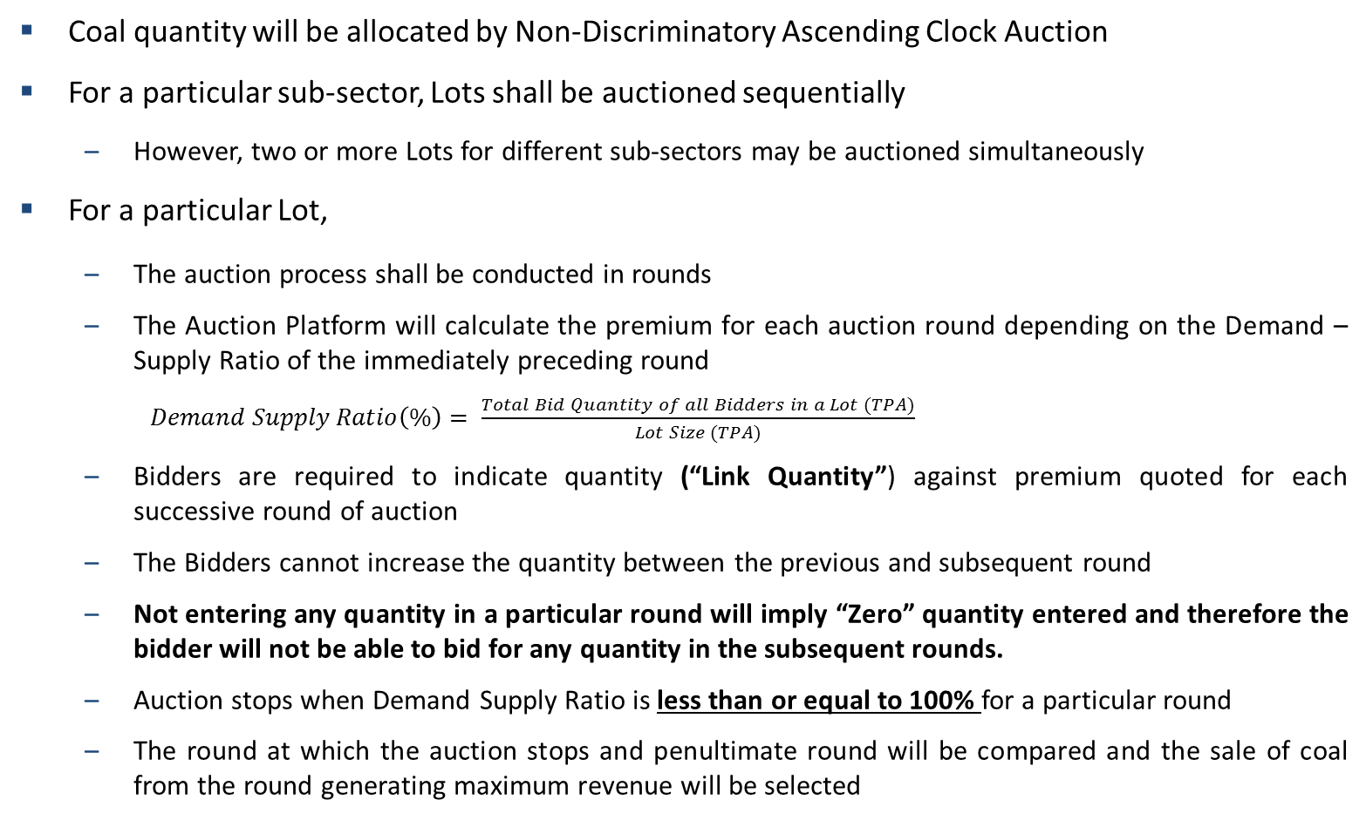
Electronic Auction Process
Coal quantity will be allocated by Non-Discriminatory Ascending Clock Auction
For a particular sub-sector, Lots shall be auctioned sequentially
  However, two or more Lots for different sub-sectors may be auctioned simultaneously
For a particular Lot,
  The auction process shall be conducted in rounds
  The Auction Platform will calculate the premium for each auction round depending on the Demand – Supply Ratio of the immediately preceding round
    $Demand Supply Ratio\left(\%\right)= \frac{Total Bid Quantity of all Bidders in a Lot (TPA)}{Lot Size (TPA)}$
  Bidders are required to indicate quantity (“Link Quantity”) against premium quoted for each successive round of auction
  The Bidders cannot increase the quantity between the previous and subsequent round
  Not entering any quantity in a particular round will imply “Zero” quantity entered and therefore the bidder will not be able to bid for any quantity in the subsequent rounds.
  Auction stops when Demand Supply Ratio is less than or equal to 100% for a particular round
  The round at which the auction stops and penultimate round will be compared and the sale of coal from the round generating maximum revenue will be selected

Slide 36
Electronic Auction Process…2
The Bid Quantity (“Link Quantity”) will be the minimum of Normative Coal Requirement or the quantity offered in a particular Lot.
The Link Quantity will be integer multiples of the 100 TPA, the “Transport Factor”
The minimum Link Quantity in any round for rail mode shall be 4,000 TPA
At the end of each round, bidders will be told the Demand Supply Ratio of that round and the corresponding Premium of the next round and the bidder shall quote the Link Quantity required under each Round subject to the following conditions:
  The Link Quantity is lower than or equal to the Link Quantity quoted in the previous Round
  The Link Quantity will be an integer multiple of 100 TPA

Slide 37
Round Premium
Premium for the first round will be Rs. Zero/ tonne
Round Premiums (other than the first Round) will depend on the Demand/Supply Ratio of the immediately preceding round and will be determined by the Auction Platform as follows:
Premium would be cumulative i.e. Premium for a particular round would be the premium at the preceding round plus the premium computed for the current round.
Demand/Supply Ratio in a particular round | Incremental Round Premium (Rs. per tonne)
Greater than 100% and less than or equal to 125% | 10
Greater than 125% and less than or equal to 200% | 25
Greater than 200% and less than or equal to 300% | 50
Greater than 300% | 100

Slide 38
Example - Non-Discriminatory Ascending Clock Auction
Ascending Price with Demand Converging to 0.5 MT Quantity Offered
0.5 MT @ INR 1410/tonne
0.60 MT @ INR 1400/tonne
10/tonne as Demand/Supply 120%
0.70 MT @ INR 1375/tonne
25/tonne as Demand/Supply 140%
0.80 MT @ INR 1350/tonne
25/tonne as Demand/Supply 160%
1.10 MT @ INR 1300/tonne
50/tonne as Demand/Supply 220%
1.65 MT @ INR 1200/tonne
100/tonne as Demand/Supply 330%
Price Increment

Slide 39
Allocated Quantity
  Each round will be considered a valid offer to purchase the Link Quantity at the stated price. Moving to the next round does not mean the previous offer is discarded or becomes invalid.
  The auction will stop once the Demand Supply Ratio is lower than or equal to 100%.
In case in any of these rounds the Demand Supply Ratio is more than 100%, bidders will be allocated their pro-rata share (rounded down to the nearest multiple of the Transport Factor).
  For example in case the pro-rata allocation of a bidder is 11,515 TPA for a Lot, the final allocation to be computed by the portal would be 11,500 TPA.
  The revenue from the last and the penultimate rounds will be compared and the and the round generating maximum revenue for CIL will be selected.
    For rounds where Demand Supply Ratio is more than 100%, the rounded down pro-rata quantity will be used for calculating the revenue to CIL.

Slide 40
Example – Allocated Quantity …2
Assuming a railway siding as the delivery point, If the round at which the auction stops has Demand Supply ratio of 98% with a notified price of Rs 1,700/tonne and total premium of Rs 360/tonne. The penultimate round has Demand Supply ratio of 102% with a notified price of Rs 1,700/tonne and total premium of Rs 350/tonne. In such a scenario, for comparing the two round, following methodology will be considered:
Since revenue at the penultimate round is more than the revenue in the round at which the auction stops, CIL may choose this round and allocate each Bidder their pro-rata share with a premium of Rs. 350 per tonne
Description | Allocation and Revenue Calculations for Penultimate Round |  |  | Allocation and Revenue Calculations for Round at which the auction stops
 | Bidder 1 | Bidder 2 | Bidder 3 | Bidder 1 | Bidder 2 | Bidder 3
Link Quantity (TPA) | 52,900 | 47,100 | 1,04,000 | 48,000 | 44,000 | 104,000
Pro-rata Allocated Quantity (TPA) | 51,863 | 46,176 | 101,961 | NA | NA | NA
Final Allocated Quantity (TPA) | 51,800 | 46,100 | 101,000 | 48,000 | 44,000 | 104,000
Total Quantity Available for Sale | 1,99,800 TPA |  |  | 1,96,000 TPA
Notified Price | Rs. 1,700 per tonne |  |  | Rs. 1,700 per tonne
Applicable Round Premium | Rs. 350 per tonne |  |  | Rs. 360 per tonne
Total Applicable Price | Rs. 2,050 per tonne |  |  | Rs. 2,060 per tonne
Total Annual Revenue | Rs. 40.96 Crore |  |  | Rs. 40.38 Crore

Slide 41
Example – Allocated Quantity …3
Assuming a railway siding as the delivery point, if the penultimate round has Demand Supply ratio of 203% with a notified price of Rs 1,700/tonne and total premium of Rs 310/tonne and the round at which the auction stops has Demand Supply ratio of 98% with a notified price of Rs 1,700/tonne and total premium of Rs 360/tonne, following methodology will be considered:
Since revenue at the round at which the auction stops is more than penultimate Round, CIL may choose the last round and allocate each Bidder their pro-rata share with a premium of Rs. 360 per tonne.
Description | Allocation and Revenue Calculations for Penultimate Round |  |  | Allocation and Revenue Calculations for Round at which the auction stops
 | Bidder 1 | Bidder 2 | Bidder 3 | Bidder 1 | Bidder 2 | Bidder 3
Link Quantity (TPA) | 91,200 | 1,05,000 | 2,10,000 | 48,700 | 45,300 | 1,02,000
Pro-rata Allocated Quantity (TPA) | 44,904 | 51,699 | 1,03,397 | NA | NA | NA
Final Allocated Quantity (TPA) | 44,900 | 51,600 | 1,03,300 | 48,700 | 45,300 | 1,02,000
Total Quantity Available for Sale | 1,99,800 TPA |  |  | 1,96,000 TPA
Notified Price | Rs. 1,700 per tonne |  |  | Rs. 17,00 per tonne
Applicable Round Premium | Rs. 310 per tonne |  |  | Rs. 360 per tonne
Total Applicable Price | Rs. 2,010 per tonne |  |  | Rs. 2,060 per tonne
Total Annual Revenue | Rs. 40.16 Crore |  |  | Rs. 40.38 Crore

Slide 42
PAYMENTS

Slide 43
Periodic Payments & Price Indexation
The premium determined through the auction process will be converted into percentage terms i.e. percentage of the notified price and this percentage premium will remain constant throughout the tenure of the FSA
Notified price will be reviewed semi-annually and any modification (upward or downward) in the notified price post such review shall be considered as indexation and such modified price will be referred as “Indexed Notified Price”.
The price charged will be the sum of (a) notified price (or indexed notified price post review if any) and (b) the percentage premium on such notified price (or indexed notified price).
An example is worked out below
Original Notified Price (Rs./tonne) | 1,700
Premium (Rs./tonne) | 250
Total Price Payable by Successful Bidder (Rs./tonne) | 1,950
% Premium over Notified Price (to remain constant) | 14.71%
Upward Revised Notified Price (Rs./tonne) | 2,000
Premium Payable @ 14.71% of Rs. 2,000 / tonne | 294
Total Price Payable by Successful Bidder after Price Revision (Rs./tonne) | 2,294
Downward Revised Notified Price (Rs./tonne) | 1,500
Premium Payable @ 14.71% of Rs. 1,500 / tonne | 214
Total Price Payable by Successful Bidder after Price Revision (Rs./tonne) | 1,714

Slide 44
Performance Security
  The Successful Bidder, shall provide to the relevant CIL Subsidiary, a Performance Security within 45 days of issuance of the LOI in the form of an Irrevocable and unconditional guarantee from an Acceptable Bank and in the format specified in the Scheme Document
  Performance Security = 6% x [Allocated Quantity of the Successful Bidder] × [Aggregate of the (Notified Price or Indexed Notified Price, as the case may be) and (% Winning Premium x Notified Price or Indexed Notified Price, as the case may be)]
  The amount of Performance Security shall be suitably revised in case of change in Notified Price
  Validity of Performance Security is till 3 months from the date of expiry of the FSA
  The Performance Security may be forfeited by the relevant Subsidiary in the manner specified in the Agreement
  [Refer to Scheme Document for details]
  “Acceptable Bank” shall mean a Scheduled Bank as listed in the Second Schedule of the Reserve Bank of India Act, 1934 excluding those listed under the headings of Gramin Banks, Urban Co-operative Banks and State Co-operative Banks

Slide 45
KEY FSA TERMS AND MODIFICATIONS IN EXISTING FSA

Slide 46
Grade Variation
In case of a variation in grade of coal (decided on the basis of third party sampling) as compared to the Allocated Quantity grade, Bidder shall pay the Notified Price (or the latest Indexed Notified Price as the case may be) of the supplied grade plus the Winning Premium (in percentage terms) on the Notified Price (or the latest Indexed Notified Price as the case may be) of the supplied grade without factoring in royalty payments, taxes etc.
Illustration:
Particulars | Case I: Supplied Grade is lower than Contracted Grade | Case II: Supplied Grade is higher than Contracted Grade
Allocated Grade to Bidder | G6 | G6
Notified Price (Rs./ Tonne) (B) | 2,280.00 | 2,280.00
Premium (Rs./ Tonne) (C) | 300.00 | 300.00
Premium as % of Notified Price (D=C/B) | 13.16% | 13.16%
Actually Supplied Grade | G7 | G5
Notified Price of Supplied Grade (Rs./ Tonne) (E) | 1,920.00 | 2,750.00
Premium of Supplied Grade (Rs./ Tonne) (F=E*D) | 252.63 | 361.84
Price Payable for Supplied Grade (Rs/Tonne) (I = E+F) | 2,172.63 | 3,111.84

Slide 47
Independent Third Party Sampling
Each Successful Bidder off-taking coal via rail mode may choose an agency from the following:
  list of independent third parties provided by CIL from time to time or
  CIMFR or CIMFR appointed agencies.
Bearing logistical issues, in case of off-take of coal via road mode, a single independent third party sampling agency will be appointed by respective CIL subsidiary for sampling coal supplied to various purchasers from a particular source
Third party sampling, if requested by the Successful Bidder, shall be done from the delivery/ loading point at supplier’s end
Costs of third party sampling
  shall be borne equally in case of transport via rail mode
  in case of transport via road 50% of the cost of third party sampling will be borne by respective CIL subsidiary and the residual 50% cost shall be shared by the parties who have requested for Third Party Sampling on a proportionate basis.
The procedure for conduct of Third Party Sampling shall be as detailed in the Agreement.

Slide 48
Key Modifications required in Existing Model FSA
Duration and Lock-in
  As per Para 1(ii) of the Policy, tenure of the FSA may be as decided by MoC subject to a maximum of 15 years
  Under the Auction Process, the Agreement shall come into force from the date of signing of the Agreement and shall be valid for a term of 5 (five) years from the date of signing. Upon expiry of the aforesaid period of 5 (five) years, the Agreement may be extended for a further period of 5 (five) years on mutually agreed terms
  The Agreement shall have a lock-in period of 2 (two) years
  Change in Control
  Change in Control of the Successful Bidder and/ or any transfer of the Specified End Use Plant along with the rights in relation to the Allocated Quantity shall be permissible with prior approval of the relevant Subsidiary if:
  Such change in Control does not result in the Successful Bidder becoming non-compliant with any of the Eligibility Conditions or the transferee of the Specified End Use Plant along with the rights in relation to the Allocated Quantity continues to satisfy all of the Eligibility Conditions
  Such change in Control and/ or transfer occurs in accordance with Applicable Law and the conditions for transfer and/ or assignment contained in the Agreement

Slide 49
Key Modifications required in Existing Model FSA …2
Exit Options
  Post the expiry of lock-in period, the Successful Bidder may seek an exit after serving a prior written notice of three months.
  If the Successful Bidder exits the Agreement prior to expiry of the lock-in period of 2 (two) years, the Performance Security shall be forfeited in its entirety and the Successful Bidder shall be disqualified from participating in the subsequent tranche of auction for the non-regulated sector conducted by CIL
  Indemnification
  The relevant Subsidiary shall be indemnified by the Successful Bidder for any claims or action that may arise inter alia on account of any misrepresentation of the Bidder misrepresentation, unwilling or otherwise

Slide 50
Key Modifications required in Existing Model FSA …3
Quantity and Compensation for short delivery / lifting
  If level of delivery by the relevant Subsidiary or level of lifting by the Successful Bidder falls below 75% (seventy five per cent.) then the defaulting party shall be liable to pay compensation to the other party in the following manner:
  The penalty shall be computed in the same manner as done slab wise for computation of income tax. However, unlike income tax the percentage of compensation shall grow on a linear basis within each slab.
  Performance Incentive
  There shall be no performance incentive under the Agreement because contracted quantity will be 100% of the EUP’s Normative Coal Requirement.
  Security
  Successful Bidder shall be entitled to create encumbrances over the Agreement or rights granted to it under the Agreement for the purposes of availing financing from a bank or financial institutions for financing the EUP without any prior approval by relevant CIL Subsidiary.
Level of Delivery/ Lifting of Coal in a Year | Percentage of Penalty for the failed quantity
Below 75% but up to 70% of Allocated Quantity | 0 - 5
Below 70% but up to 65% of Allocated Quantity | 5 - 10
Below 65% but up to 60% of Allocated Quantity | 10 - 20
Below 60% | 20 - 40

Slide 51
Key Modifications required in Existing Model FSA …4
Termination
  Failure of a party to perform its obligations under the Agreement because of a force majeure, for a period beyond 90 (ninety) days in any continuous period of 180 (one hundred eighty) days
  Successful Bidder being prevented /disabled under Applicable Law from using coal, for reasons beyond their control
  Any material change in the coal distribution system of the relevant subsidiary of CIL due to a Government directive/ notification, post the execution of the Agreement
  The matter pertaining to the diversion or breach of end use of coal leads to suspension of the deliveries and the matter cannot be resolved
  Encashment of the Performance Security or suspension of coal supplies
  In the event a party suffers insolvency, appointment of liquidator (provisional or final), appointment of receiver of any of material assets, levy of any order of attachment of the material assets, or any order or injunction restraining the party from dealing with or disposing of its assets
  A party commits a breach of terms or conditions of the Agreement

Slide 52

THANK YOU
New Delhi (Regional Office) | World Trade Tower Ground Floor Barakhamba Lane New Delhi – 110 001 | T: +91 (11) 2348 5200 F: +91 (11) 2341 8773

Slide 53
Consumption Norms as per CIMFR – Cement
Process |  | Wet | Semi-dry | Dry
Grade | Average GCV (kcal/kg) | kg of coal/ ton of clinker | kg of coal/ ton of clinker | kg of coal/ ton of clinker
G1 | 7,150 | 185 | 129 | 111
G2 | 6,850 | 193 | 135 | 116
G3 | 6,550 | 202 | 141 | 121
G4 | 6,250 | 212 | 148 | 127
G5 | 5,950 | 223 | 156 | 134
G6 | 5,650 | 235 | 164 | 141
G7 | 5,350 | 248 | 173 | 149
G8 | 5,050 | 262 | 183 | 157
G9 | 4,750 | 279 | 195 | 167
G10 | 4,450 | 298 | 208 | 179
G11 | 4,150 | 319 | 223 | 192
G12 | 3,850 | 344 | 240 | 207
G13 | 3,550 | 373 | 261 | 224
G14 | 3,250 | 408 | 285 | 245

Slide 54
Consumption Norms as per CIMFR – Cement …2
Notes:
Where a Bidder has specified one or more Kilns (in a single location within the same boundary) as the Specified End Use Plant, the Normative Coal Requirement shall be assessed on the basis of configuration of each such individual Kiln based on the abovementioned consumption norms.
The Normative Coal Requirement shall be calculated based on an assumption of 85% (eighty five per cent.) capacity utilization on an annual basis.
Any existing linkage quantity (deemed to be G10 grade of coal) shall be reduced from the Normative Coal Requirement arrived based on the above.
Further, the peak rated capacity of any coal mine allocated under Coal Mines (Special Provisions) Act, 2015 and/or Mines and Minerals (Development and Regulation) Act, 1957 as amended (pro-rated for the Specified End Use Plant in the event of a combination of end use plants to which the mine was allocated), adjusted for grade, shall be reduced from the Normative Coal Requirement arrived based on the above.

